Slide 1

Android Accessibility for Developers
Quintin Balsdon
Notes:
A lot of the time developers get told about accessibility in a second hand manner. We get informed that there are problems due to some esoteric mechanism of using the phone that we were completely unaware of and must fumble around until we fix the issue and dread any further bugs cropping up. This was the manner in which I was introduced to accessibility features and testing in Android.
An astute developer might even go as far to watch the various YouTube videos on how TalkBack and other accessibility features are changing for users, but only recently has there been any content specifically aimed at developers, and that is dangerous, because if we don’t know how people need to use these services, how are we to implement them? Accessibility features can be difficult to manage, and the barrier to entry can be quite high for people who are just trying to make it through the work day. A lot of these elements are hidden behind complex menu systems and can severely affect focus. Did you know the mechanism to turn on the feature to display speech output as toast messages is “Settings -> Scroll Down -> Accessibiliy -> TalkBack -> Settings -> Advanced Settings -> Developer Settings” – I have people on LinkedIn emailing me JUST to ask how to do this. There is no alternative mechanism. But I’ll get to that later.
We need to remember that inclusive design is good for everyone as demonstrated by the curb-cut effect…

Slide 2

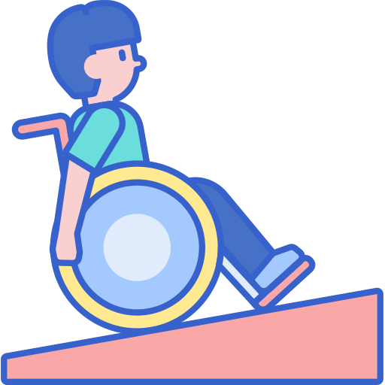

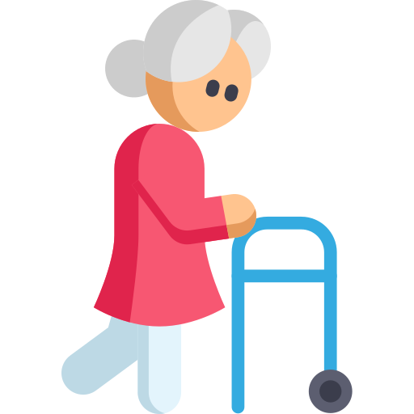
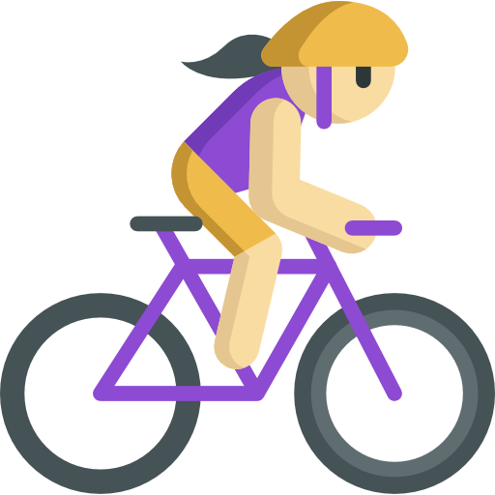
The curb-cut effect
Notes:
…where all users benefit from universal design. The curb cut effect is the phenomenon that demonstrates disability friendly design benefiting a larger group than the initially intended audience. It originates from the introduction of curb-cuts for wheelchair users, those small ramps we find on sidewalks.
So it’s not about reaching small percentages of the population, or meeting some legal requirement, it’s about making things inclusive. Ensuring everyone can experience independence in all their interactions should be our utmost priority.
From curb-cuts helping people who use sidewalks to closed captions allowing everyone to understand a television screen in a noisy public space, it is universally demonstrated that the earlier someone considers accessibility, the better the end result will be, and will result in fewer bugs down the line.

Slide 3
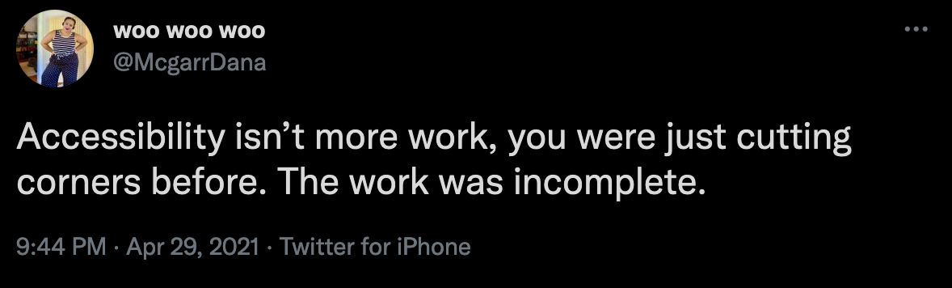


Accessibility and the SDLC
Analysis
Design
Implement
:LABEL
Button
Link
Test
Role
Node Info
Deploy
Maintain
Notes:
https://twitter.com/McgarrDana/status/1387870476178006020
As mobile devs, we are not always included in all the phases of our projects. We mustn’t let that get in the way of raising issues as soon as possible.
When we compromise quality in the name of release time, we find ourselves in a reactive cycle and doing more work several times over. Not only that, but we become reluctant to make big, possibly necessary, changes to the existing implementation and can end up with patchy code. If you rush things out the door, you end up having to constantly protect yourself by making excuses like you’re still in beta. (CLICK)
I have seen in several apps something like these two elements: Links that look like buttons and buttons that look like links, because we want them to fit nicely in a list of elements. It becomes difficult to navigate this because as developers we aren’t always around during the design phase, and it might happen that you’ll be required to implement something like this. In that case, it becomes helpful to ask before development begins the manner in which elements like this will be announced. The answer might yield a change in design, or at least inform us as developers of the appropriate approach to take.
When these questions are not asked, a developer implementing our button would simply make a label and add an onclick listener [CLICK]. When the bug is raised that it does not announce as a button, they might try to fix it by changing the Role attribute (if they know about it) or even worse change the accessibility announcement to include the word “button.” It’s important to note that both of those solutions, role and announcement, are not sufficient to comply with AAA WCAG standards (specifically 1.3.6)
I have found that when developers ask these kind of questions, and get into this manner of thinking, they’ll start the work right. So instead (in the case of the button on the left) of an Android Label and onclick listener, they will rather just style a button.
Sometimes we may have to go to some further effort, for example it’s quite common to have a standard component that needs a custom layout file, such as a checkbox with more details than simple text. In these cases we need to override the appropriate control in code and provide a custom layout. I do have hope that Jetpack compose will make this process a lot easier with it’s declarative style.

Slide 4
How users interact with devices
Notes:
https://webaim.org/projects/screenreadersurvey8/#wcag
Looking at the WebAim 2019 survey results we can glean insight into users preferred navigation mechanisms, and I would strongly suggest you check it out.
It would appear from the survey that when navigating information on a lengthy web page, the first thing screen reader users will do, generally, is navigate by headings. This is an important highlight for us writing apps – ensuring that we have appropriate headings marked as such in our applications. It also tells us that users of these features are not fond of going though lengthy screens…
While we shouldn’t let results like this skew our focus on all-encompassing great UX, it does provide some “low hanging fruit” in terms of the more important aspects of navigational sugars that can improve the quality of the user experience.
A lot of these are details that can apply to other types of projects, like web, iOS, etc – so let’s start talking Android

Slide 5



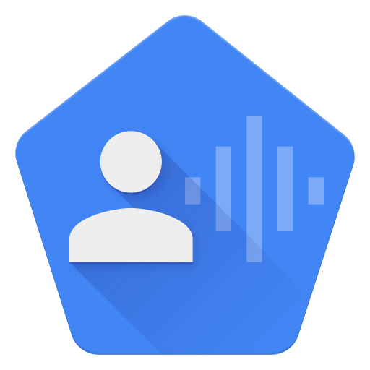
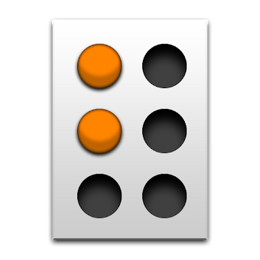
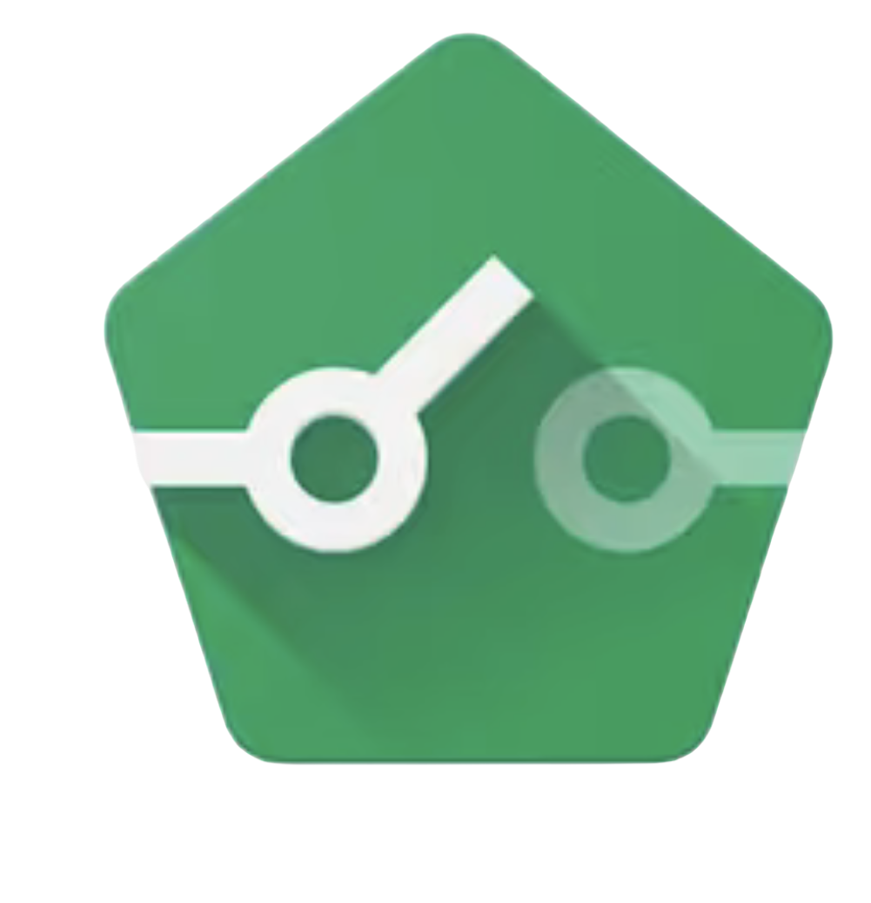
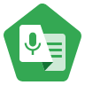
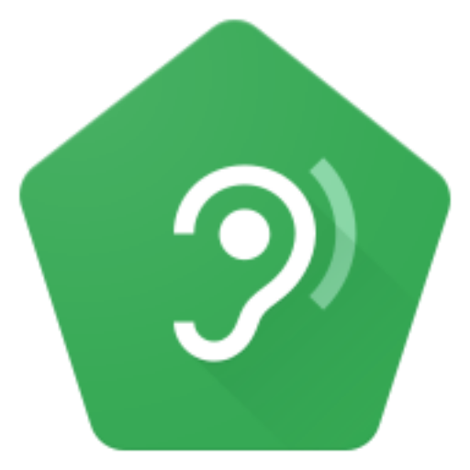
Android accessibility apps
Notes:
It would be disingenuous to call Google lazy when it comes to accessibility. The Accessibility suite alone contains elements such as TalkBack, Switch Access, Select to speak, Live Caption, Magnification, Colour Correction to name a few. Every time I look I see talented individuals at Google who really care about the content they produce. And they want feedback.
As developers it’s important for us to be aware of the different mechanisms that users can employ to use our apps, so that we can provide the best possible experience for everyone, but also through usage of these tools we can make them better for those users. We might even learn something new about our apps and the perceptions we create.
Some of these offerings will be more difficult for developers to use with zero experience, for example BraileBack requires specialised hardware and knowledge, but it works closely in tandem with TalkBack. However getting users to test the app is always a good idea.

Slide 6
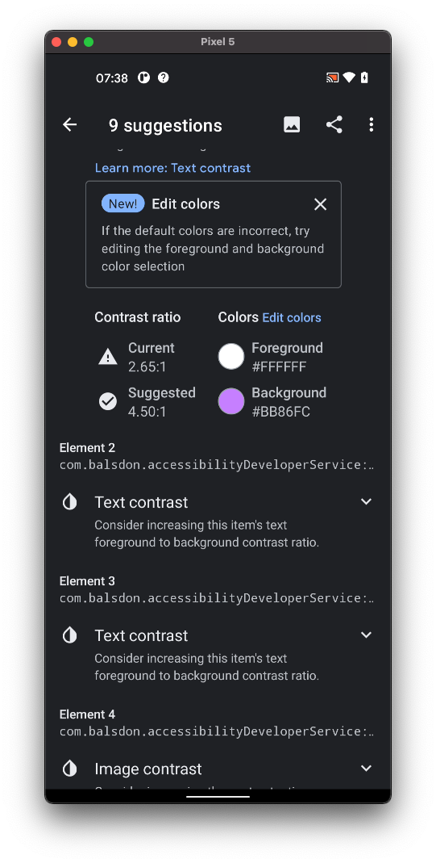




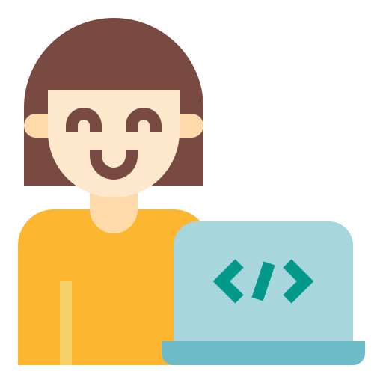
Android accessibility tools
Notes:
The Android accessibility scanner is a super useful app to use for checks that would be difficult to test ourselves. It can offer suggestions based on the size of buttons and colour contrasts.
[CLICK] For instrumentation tests, the Android Accessibility Test Framework also provides accessibility feedback on the same type of criteria.
[CLICK] The Google play console also has what is called “Pre launch reports” which are automatically generated when an APK is uploaded onto the store.
[CLICK] There are also accessibility services, that developers can write specifically to perform accessibility analysis and actions on behalf of users.
[CLICK] Ultimately, we need to be familiar with how our users interact with our apps, and test them using the available technologies as best as we can. For a long time I wasn’t aware aware of a feature called “Give me time” which is an API call that allows developers to get the appropriate amount of time to allow a user to react given their needs, called “getRecommendedTimeoutMillis”. This is in cases where a message may be displayed that will automatically disappear from view if it is not acted upon appropriately.
But first let’s understand how input works in Android [CLICK]

Slide 7

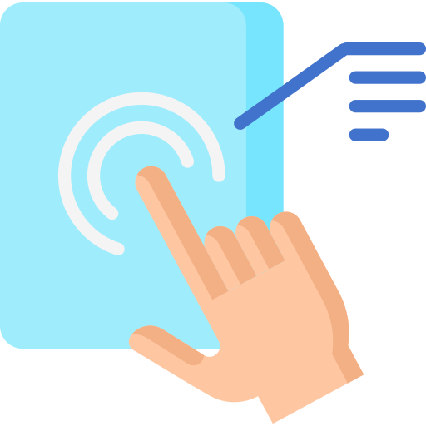

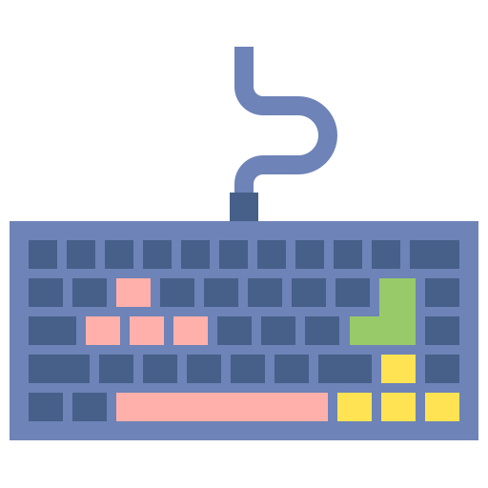

How Input works
Input layer
App layer
Device
Event
ADB
A11y
Notes:
It’s important to understand the layering involved with input in order to understand a service like TalkBack. TalkBack is not a part of the underlying operating system, it’s a privileged app within the ecosystem. This explains why some developers may struggle to understand why certain things don’t work the way they expect.
When input comes in from a user, normally via the touch screen, it will go through the input layer, allowing the app to determine the manner in which the app will handle the input. It then goes down into the app layer which will determine how else that input can be used and log it to the device.
But now as developers we can interact with a tool known as the Android Debug Bridge, which, for the most part, can be the same as interacting directly with an app [CLICK]. This is why when we use the ADB to do text input and swipes we can create some great automation tools and scripts.
However this is also where a problem comes in [CLICK]. The app is now responsible for determining what types of input it will treat as accessibility input as opposed to general input. It has added a layer to which certain types of input no longer have access. Because accessibility apps are just apps, they present and manage a new layer to the user, distinguished by the name ”accessibility layer" as opposed to "input layer”, to which the ADB has no access. If we try to perform accessibility actions they are not registered when using the ADB. This is not so much a bug but rather an important consideration when trying to understand the ecosystem. But it has lead to some complicated interactions that do not just affect my little scripts. So far I have found at least 3 bugs that have nothing to do with the Android Debug Bridge and everything to do with Accessibility Services.

Slide 8
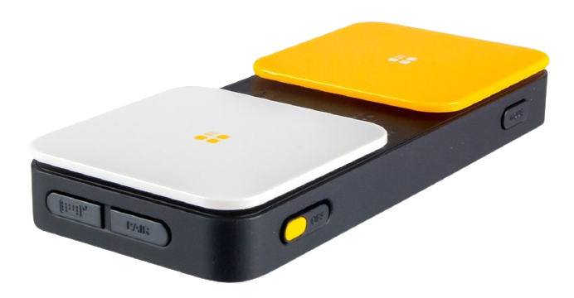
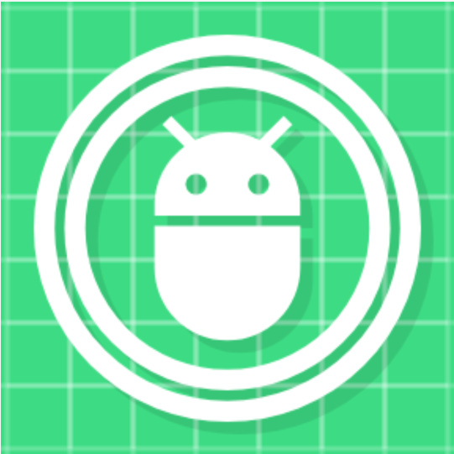
Stuff I wrote
Notes:
I am quite disappointed, because as much as Google does, there are a few glaring holes in making the tools available to developers. They have this rich resource known as the Android Debug Bridge and there is a lot of power of scripting through it. Most system settings can be managed here and it's absolutely focus-friendly when a developer can modify settings with one line rather than navigating through complex settings.
It’s the command line to the heart of a device and you do have to voluntarily activate it through a hidden menu. So it’s secure and opt-in, but it's highly under-utilized.
For example, Switch Access [CLICK]: Google has made it optional for developers to use the VOLUME UP and VOLUME DOWN keys to emulate a switch controller that someone with motor impairments may use to control the screen.
However I am sure you can see from this a user will be able to do far more than just 2 key presses, no matter how imaginatively you use them.
I do think the barrier to entry for an Android developer should end at a computer, and not being able to test switch access effectively without yet another hardware device, which would either occupy the power connection or require Bluetooth and cluttering our workspaces unnecessarily. Especially when we have such a powerful tool as the ADB.
[CLICK]

Slide 9
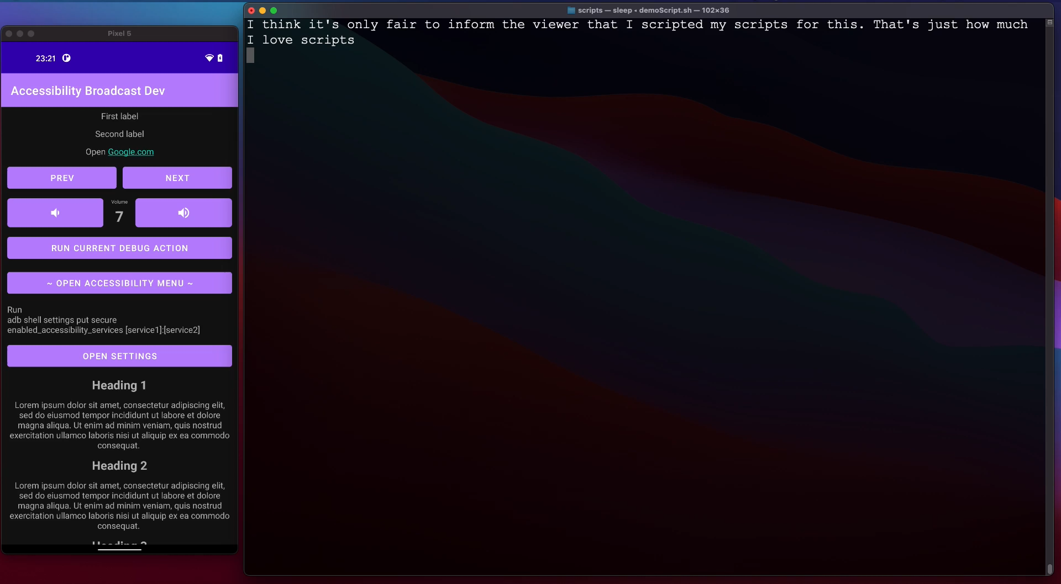
Notes:
So what I have done is started writing accessibility services for developers and automation testers. This allows us to use the ADB via the command line to navigate the device in a granular and controlled manner. A developer can now navigate the accessibility landscape using a tool that is familiar to them in order to test their apps as suggested.
However there are limitations: Accessibility Services themselves have no access to the other accessibility services (my service cannot tell which element TalkBack / Switch Access will focus on next or previous, [BREATH] read or modify the current navigation granularity (default vs headings), or tell what gesture is mapped to what action, or even open the accessibility menu – all of these are bugs that I am in the process of reporting to Google)

Slide 10
Takeaways
It’s not us versus them
Doing this work shows a desire for quality and inclusion, and should be presented as such
This is a similar argument to doing proper tests
Know the guidelines
Difference between AA and AAA
Check WCAG
Do user studies
Mobile Testing Methodology: https://youtu.be/CD1A-_zcH-4
Notes:
I think all of this could somehow be interpreted as a criticism to the manner in which we do work now. For example sometimes when I find a case study so good I keep talking about it and the developer who did it actually apologized to me. I felt so bad because that wasn’t the case at all. I have seen that by being more inclusive and considerate of other the quality of my work improves, and I have less bugs and better looking apps.
But it’s also very important that in doing all of this we include those people in our testing at all phases. We must never fall into the pattern of “oh I like it this way” or even worse “oh they’ll like it like this” – speaking on behalf of others, no matter what kind of user they may be, is a bad idea. That is why the WCAG is so helpful.

